Slide 1
Mobile Commerce - Outline
Introduction
Characteristics of M-commerce
Enabling Technologies
Mobile Payment
Conclusion

Slide 2
The Drivers
Widespread availability of devices
No need for a PC
Handset culture
Vendors’ push
Declining prices
Improvement of bandwidth
Explosion of EC in general

Slide 3
Mobile Commerce: Overview
Mobile commerce (m-commerce, m-business)—any e-commerce done in a wireless environment, especially via the Internet
  Can be done via the Internet, private communication lines, smart cards, etc.
  Creates opportunity to deliver new services to existing customers and to attract new ones

Slide 4
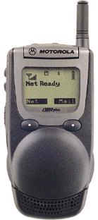
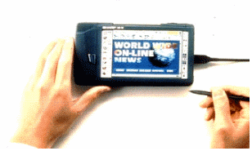

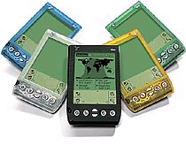
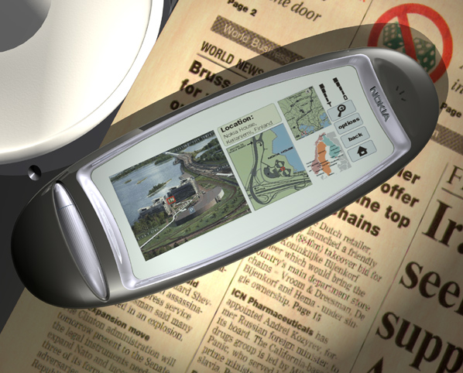
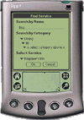
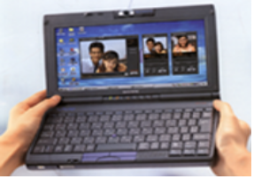

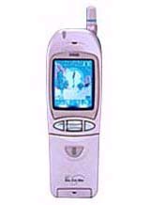
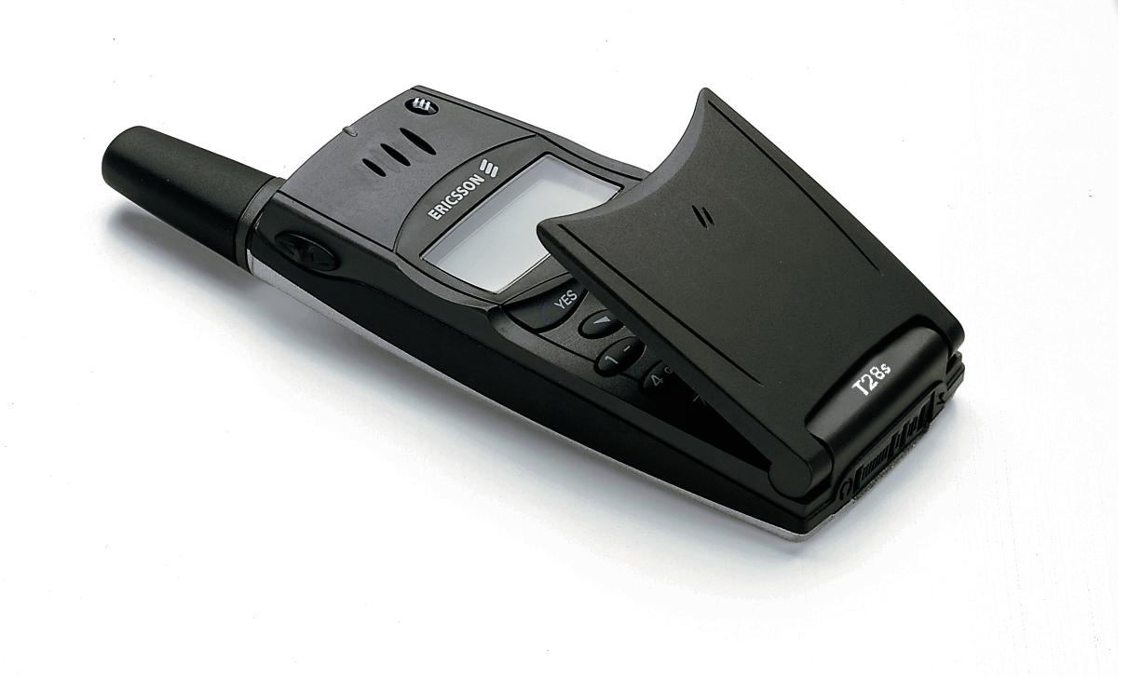
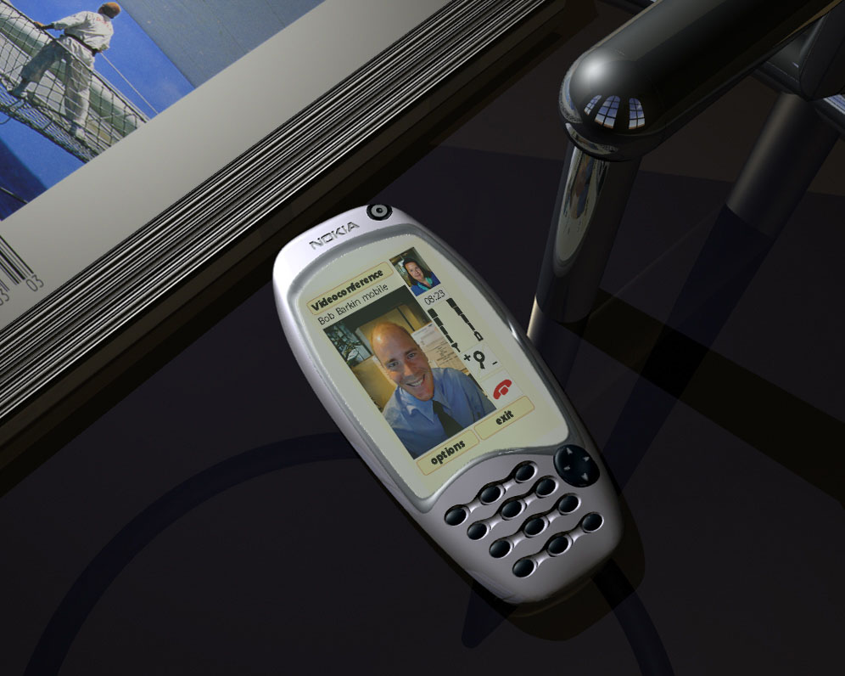
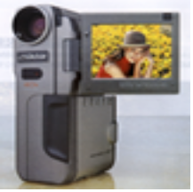
Mobile Interfaces

Slide 5
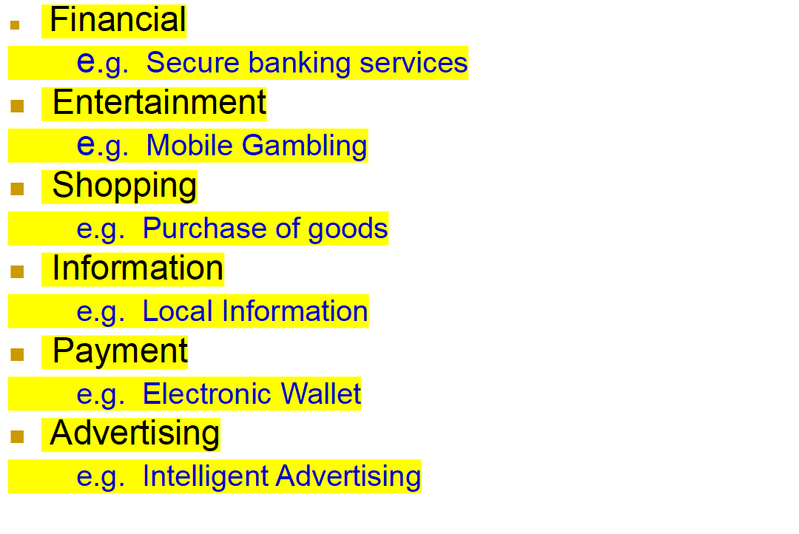
Classification of M-Commerce Services

Slide 6
Characteristics of M-Commerce
Value-added
attributes
Characteristics
Product and service
localization
Product personalization
Ubiquity enhancement
Instant connectivity
Convenience
Mobility
Mobile
Commerce
Reachability

Slide 7
A Example (The next bus model)
The Problem
  Buses in San Francisco have difficulty keeping to 20 minute schedule during rush hours
  Posted schedule becomes meaningless
The Solution
  Bus riders carrying Internet-enabled cell phone or PDA helps:
    Find estimated arrival time at each stop, digitally in real time
    Soon location-based advertisements will pop up—you have time to get a cup of coffee before the bus arrives—Starbuck’s is 200 feet to the right

Slide 8
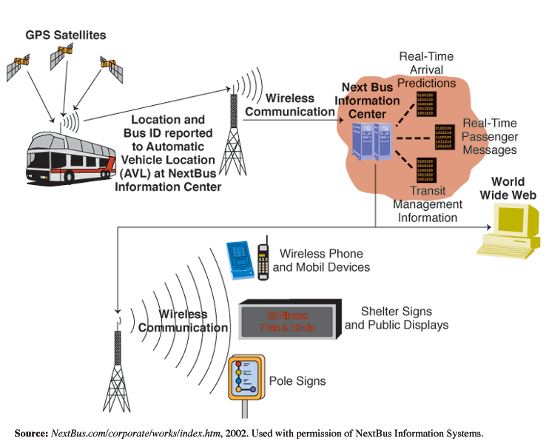
NextBus Operational Model
Localization
Connectivity
Ubiquity
Convenience

Slide 9
NextBus (cont.)
The Results
  Passengers in San Francisco are happy with the system
    Worries about missing the bus are diminished
    May discover they have time for a cup of coffee before the bus arrives
  Bus company can:
    Schedule better
    Arrange for extra buses when needed
    Improve operations

Slide 10
Enabling Technologies
Introduce two transmission mode, GPRS and W-CDMA
GPRS (General Packet Radio Service)
  A step between GSM and 3G cellular networks.
  Transmission rate via a GSM network within 9.6Kbps ~ 115Kbps.
  GPRS supports the widespread range of bandwidth, it is a effective application under the limited bandwidth.
  Mobile phone can receive and transmit data at the same time. (e.g. make a phone call and receives e-mail at the same time)
W-CDMA (Wideband Code-Division Multiple Access)
  the transmission technology for third generation (3G) UMTS mobile communication.
  The transmission rate is up to 2Mbps, it makes mobile multimedia grows rapidly.

Slide 11
Enabling Technologies (cont.)
WAP(Protocol) and i-mode(Service)
WAP(Wireless Application Protocol)
  It is a open and standard wireless application software protocol.
  The WAP system are composed of two main factors：
    WML（Wireless Markup Language）: similar to HTML
    WAP Gateway / Proxy : to change the webpage source code to the suitable one.
  Need a connecting action
  Payment according to time used.
i-mode
  The first packet-based, always-on, mobile Internet service
  Various services available : Banking, game, wallpaper, music….
  Payment according to packets received.

Slide 12
Enabling Technologies (cont.)
Other related technologies
  J2ME (Java 2 Micro Edition)
  A kind of programming language used in small, connectable consumer and embedded devices. it makes mobile phones have a ability to execute program.
  XML（eXtensible Markup Language）
  A Standard for structured document interchange on the Web. It makes the description language used by different browsers can be changed more quickly.
  IPv6
  IPv4 use 32bit, this is not enough. IPv6 expand it to 128bit, so that every mobile phone can get its own IP.

Slide 13






Mobile Payment Players
Content
Provider/
Merchant
Financial
Institution
User
Network
Operator

Slide 14
Mobile Payment Issues
Content
Provider/
Merchant
Network
Operator
Financial
Institution
User
Security
Privacy
Ease of Use
Devices
Open Standards
Inter-operability
Roaming
Authentication
Integrity
Non-repudiation
Fraud reduction
Getting Paid
User adoption
Low Cost
Issues

Slide 15






Mobipay system
Vending
Machine
OR
Internet
Merchant
Mobipay
System
with Access
Node router
Processor
+Issuer/
Acquirer
Product .....:
REF. 1234
WEB
WEB
8
2
1
4
4
7
+
5
6
3
GSM
8
REF:
01021234
1500 ptas
Store X
PIN:
12345
Delivery
REF 1234
Store x
OK
REF:
01021234
1500 ptas
Store X
PIN:
- - - - -
REF:
01021234
Alternative:
+ PIN
))))   
OPERATOR NETWORK
4. Data validation
1. User chooses Mobipay payment
method on merchant site
5. PIN request
If PIN
not
entered
directly
2. Merchant sends unique Mobipay
reference asociated with amount
6. PIN response
User
7. Authorisation
3. User sends reference (+ PIN)
8. Confirmation

Slide 16
Conclusion
Meteoric growth of the Internet and mobile communications
Increasing mobility
New applications, services and business models
Enabling technologies
Annual growth 1990-1999
6%
Telephone
lines
Cellular
subscribers
52%
Internet
hosts
87%

Slide 17

Internet Waves
GOVERNMENT & RESEARCH
EMAIL
WORLDWIDE
WEB
WIRELESS / MOBILE
INTERNET
EMBEDDED INTERNET
Today
Source: Motorola.

Slide 18
Thank you for your attention!

Slide 19
Reference
http://misbridge.mccombs.utexas.edu/knowledge/topics/mcom
http://www.fenestrae.com/
http://www.ti.com/tiris/docs/applications/pos/retail.shtml
http://www.ericsson.com/technology/
前人的投影片
Computer networking(third edition,James F.Kurose Keith W.Ross)

